Slide 1

Software Testing Techniques

Slide 2
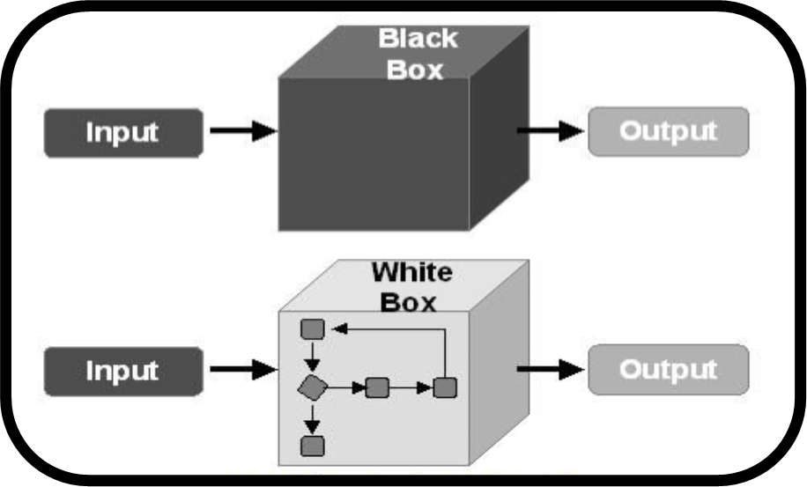
Software Testing Techniques
Black Box Testing
White Box Testing

Slide 3
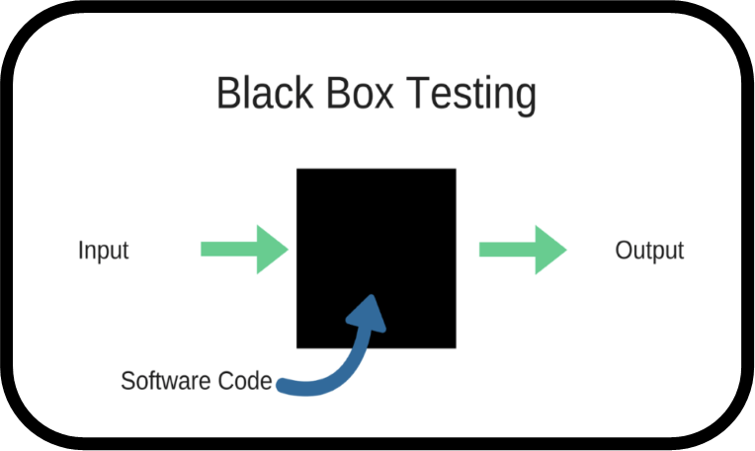
Black Box Testing
Knowing specified function that a product has been designed to perform, tests can be conducted that demonstrate each function is fully operational while at the same time searching for errors in each function.

Slide 4
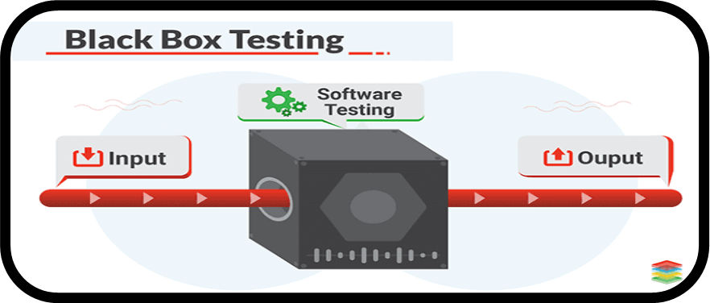
Black Box Testing
Focus on interfaces
Inputs and outputs
Integrity of external information e.g., a database

Slide 5
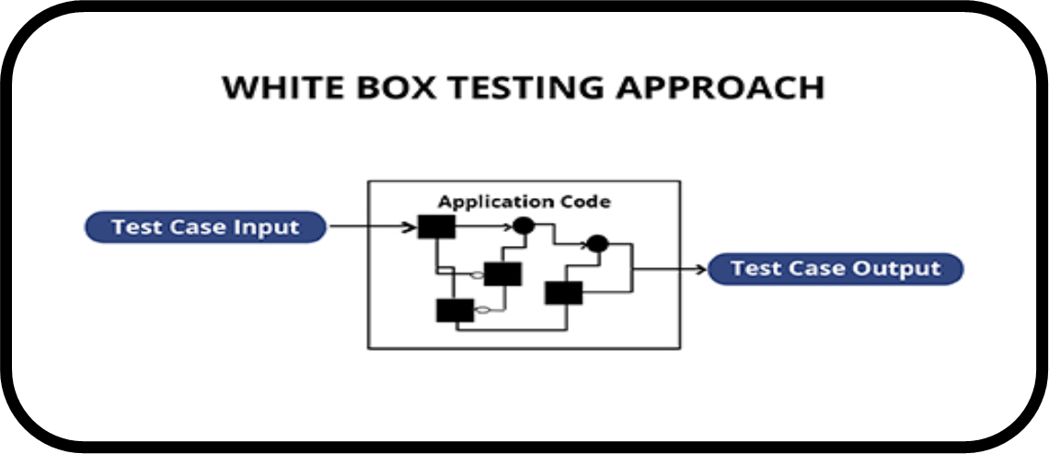
White-Box Testing
... our goal is to ensure that all
statements and conditions have
been executed at least once ...

Slide 6
Why Cover?
White-Box Testing
logic errors and incorrect assumptions
are inversely proportional to a path's
execution probability
we often
believe
that a path is not
likely to be executed; in fact, reality is
often counter intuitive
typographical errors are random; it's
likely that untested paths will contain
some

Slide 7

White-Box Testing
Cyclomatic Complexity:
It is a software metric that provides a quantitative measure of the logical complexity of a program
“The value computed for Cyclomatic complexity defines the number of independent paths in the basis set of a program and provides us with an upper bound for the number of tests that must be conducted to ensure that all statement have been executed at least once”.

Slide 8
White-Box Testing
Cyclomatic Complexity
V(G) of a flow graph G:
  Number of simple predicates (decisions) + 1
  or
  V(G) = E-N+2 (where E are edges and N are nodes)
  or
  Number of enclosed areas + 1
  In this case V(G) = 4

Slide 9
Example
    while(value[i] != -999.0 && totinputs < 100)
    { totinputs++;
    if(value[i] >= min && value[i] <= max)
    { totvalid++;
    sum = sum + value[i];
    }
    i++;
    }

Slide 10
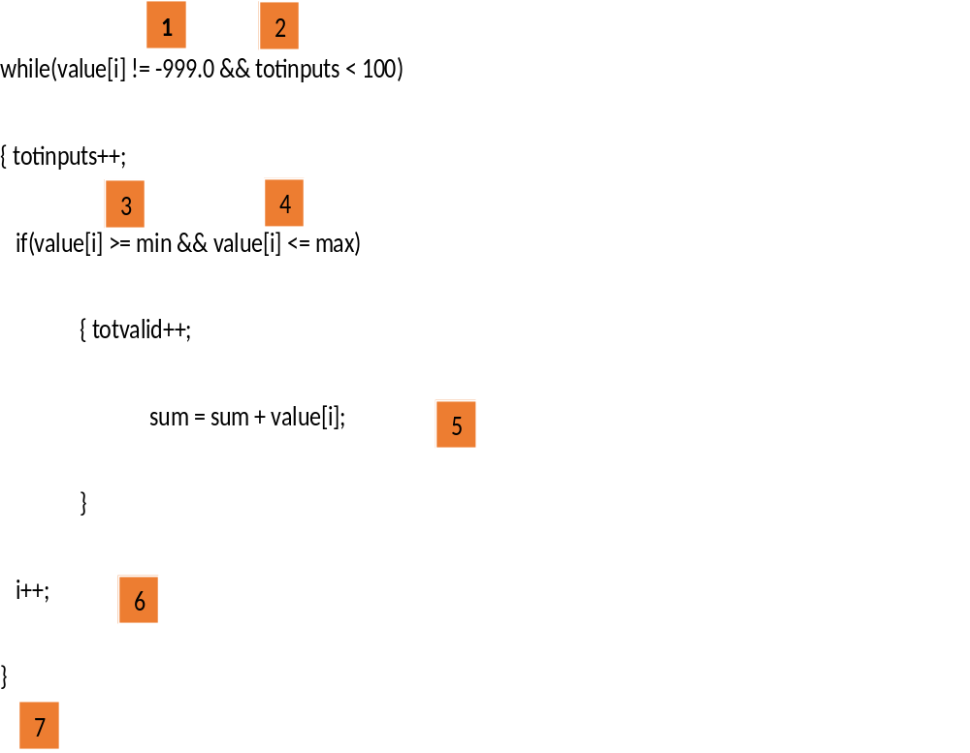
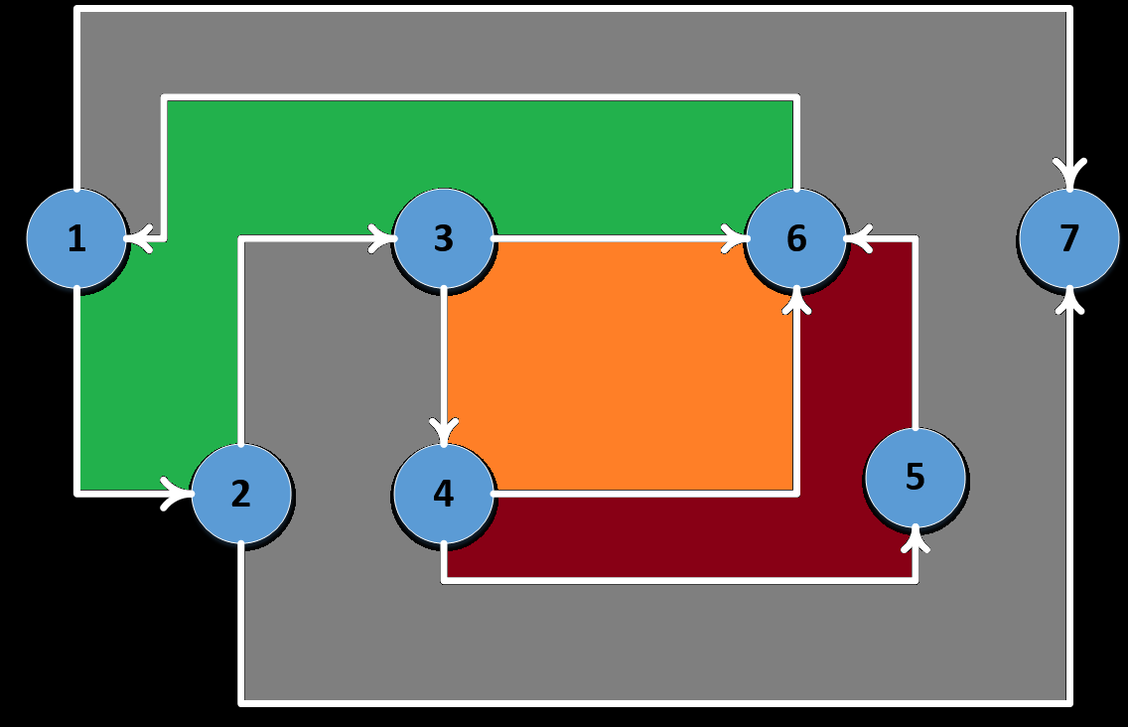

Slide 11
Cyclomatic Complexity:
  V(G) = number of enclosed areas + 1 = 5
  V(G) = number of simple predicates + 1 = 5
  V(G) = edges - nodes + 2 = 10 - 7 + 2 = 5

Slide 12
Cyclomatic Complexity by Graph Matrix
 | 1 | 2 | 3 | 4 | 5 | 6 | 7 | Calculations
1 |  | x |  |  |  |  | x | = 2 | = 2-1 = 1
2 |  |  | x |  |  |  | x | = 2 | = 2-1 = 1
3 |  |  |  | x |  | x |  | = 2 | = 2-1 = 1
4 |  |  |  |  | x | x |  | = 2 | = 2-1 = 1
5 |  |  |  |  |  | x |  | = 1 | = 1-1 = 0
6 | x |  |  |  |  |  |  | = 1 | = 1-1 = 0
7 |  |  |  |  |  |  |  | --- | ---
Cyclomatic Complexity |  |  |  |  |  |  |  |  | = 4 + 1 = 5

Slide 13
Independent Paths:
1-7 (value[i] = -999.0)
1-2-7 (value[i] = 0, totinputs = 100)
1-2-3-6-1-7
1-2-3-4-6-1-7
1-2-3-4-5-6-1-7

Slide 14
Black-Box Testing
Also called Behavioral Testing or Functional Testing
Focus on:
Functional Requirements of the software i.e. Inputs, Outputs
Structure of program is not considered
  Black box testing is not an alternative to white box testing.
  Different kind of errors are uncovered in each technique.

Slide 15
Black-Box Testing
requirements
output
input
events

Slide 16
Black-Box Testing
Equivalence Partitioning:
Since exhaustive testing is not possible so:
Divide the domain of all the inputs into a set of equivalence classes
Example: Determine absolute value for integer
Two behaviors: 1. For positive integers
2. For negative integers
Two classes will be formed: One for positive integers
Second for negative integers
Similarly for valid and invalid inputs we have two classes

Slide 17
Equivalence Partitioning
If we have input condition: 0 < count < Max
Three behaviors:
1. valid in put i.e. count within range
2. upper bound (Invalid)
3. lower bound (Invalid)
Three classes will be formed:
One for valid inputs
Second for upper bound
Third for lower bound

Slide 18
Black-Box Testing
Boundary Value Analysis:
It is observed that programs that work correctly for a set of values in an equivalence class, fail on some special values i.e. on boundaries.
We choose an input from equivalence classes that lies on the edge of class
Example: if range is 0.0 < x < 1 then test cases are:
Valid inputs: 0.1, 0.9
invalid inputs: 0, 1

Slide 19
Black-Box Testing
Boundary Value Analysis: A guide line
If an input conditions specifies a range
If an input condition specifies a number of values
Same guideline for output conditions
Boundaries of data structures are also tested.

Slide 20
Practice Quiz
void fib (int x)
{
int a=0,b=1,sum=0;
for(int i=1;i<=x;i++)
{
sum=a+b;
cout<<sum<<"\t";
a=b;
b=sum;
}
}

Slide 21
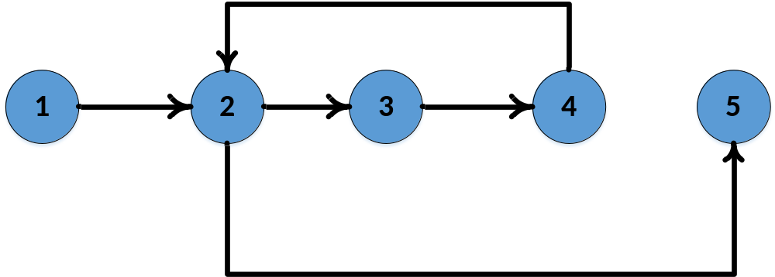
Solution
Cyclomatic Complexity:
Number of regions = 2
Number of predicates = 1+1 = 2
Edges – Nodes + 2 = 5 – 5 + 2 = 2

Slide 22
Practice Question
Public boolean find(int key)
{ int bootom = 0; int top = elements.length-1; int last index = (bottom + top)/2; int mid;
boolean found = key == elements [lastIndex];
while ((bottom <= top) && !found )
{
mid = (bottom + top) / 2;
found = key == elements[mid];
if (found)
{
lastIndex = mid;
}
else
{
if (elements[mid] < key)
{
bottom = mid +1;
}
else
{
top = mid – 1;
}
}
}
}

